Slide 1

Computer Networks
Error Correction Code
S.V.Jansi Rani
Associate Professor / CSE

Slide 2
AGENDA
Error Correction Code
Hamming Code

Slide 3



Slide 4
Error Correction
~ can be handled in two ways
✶ when an error is discovered, the receiver can have the sender retransmit the entire data unit.
✴ a receiver can use an error-correcting code, which automatically corrects certain errors.

Slide 5
Error Correction(cont’d)
Single-Bit Error Correction
parity bit
The secret of error correction is to locate the invalid bit or bits
For ASCII code, it needs a three-bit redundancy code(000-111)

Slide 6
Error Correction(cont’d)
If the total number of bits in a transmittable unit is m+r, then r must be able to indicate at least m+r+1 different states
2^{r} ≥ m + r + 1
ex) For value of m is 7(ASCII), the smallest r value that can satisfy this equation is 4
2⁴ ≥ 7 + 4 + 1

Slide 7
Error Correction(cont’d)
Relationship between data and redundancy bits
Number of Data Bits
(m)
Number of Redundancy Bits
(r)
Total Bits
(m+r)
1
2
3
4
5
6
7
2
3
3
3
4
4
4
3
5
6
7
9
10
11

Slide 8
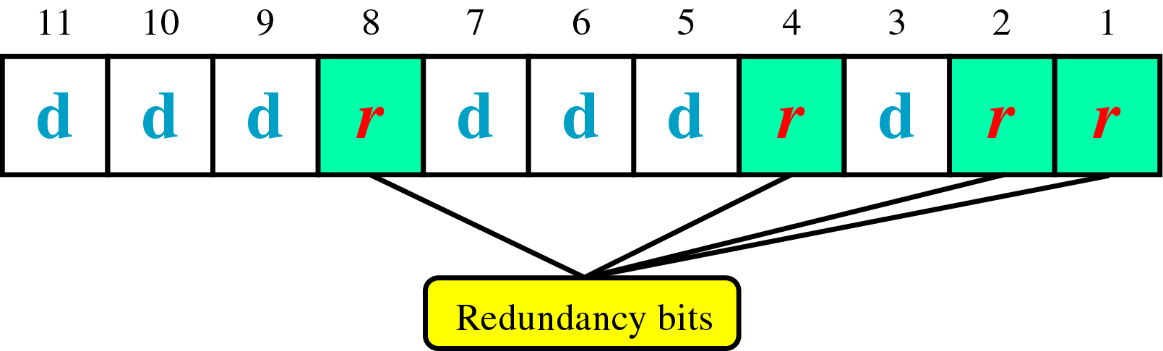
Error Correction(cont’d)
Hamming Code
~ developed by R.W.Hamming
positions of redundancy bits in Hamming code

Slide 9
Error Correction(cont’d)
each r bit is the VRC bit for one combination of data bits
r₁ = bits 1, 3, 5, 7, 9, 11
r₂ = bits 2, 3, 6, 7, 10, 11
r₄ = bits 4, 5, 6, 7
r₈ = bits 8, 9, 10, 11
Position 1: check 1 bit, skip 1 bit, check 1 bit, skip 1 bit, etc. (1,3,5,7,9,11,13,15,...) Position 2: check 2 bits, skip 2 bits, check 2 bits, skip 2 bits, etc. (2,3,6,7,10,11,14,15,...) Position 4: check 4 bits, skip 4 bits, check 4 bits, skip 4 bits, etc. (4,5,6,7,12,13,14,15,20,21,22,23,...) Position 8: check 8 bits, skip 8 bits, check 8 bits, skip 8 bits, etc. (8-15,24-31,40-47,...) Position 16: check 16 bits, skip 16 bits, check 16 bits, skip 16 bits, etc. (16-31,48-63,80-95,...) Position 32: check 32 bits, skip 32 bits, check 32 bits, skip 32 bits, etc. (32-63,96-127,160-191,...) etc.

Slide 10
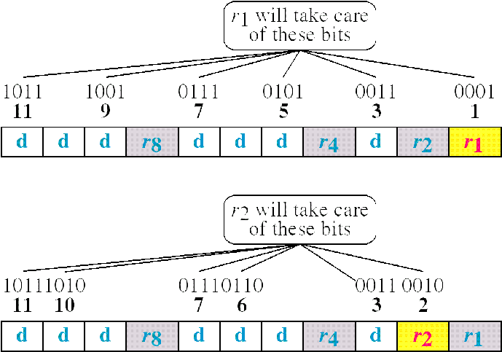
Error Correction(cont’d)
Redundancy bits calculation(cont’d)

Slide 11
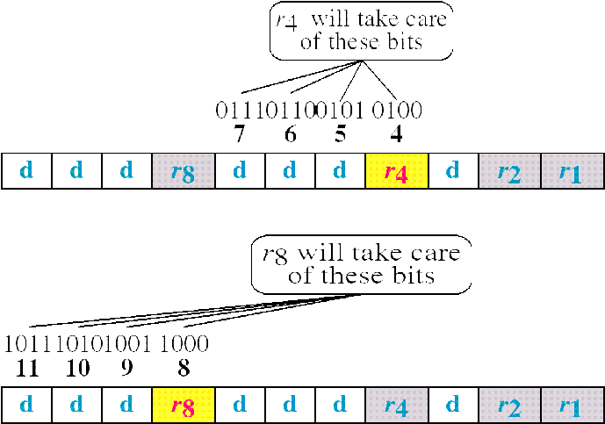
Error Correction(cont’d)
Redundancy bits calculation

Slide 12
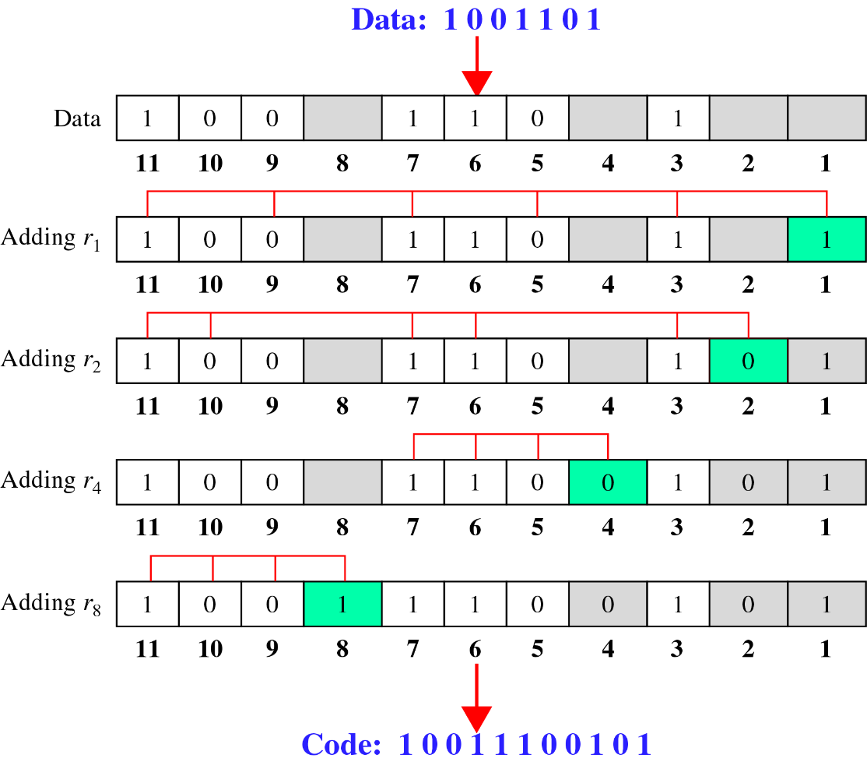
Error Correction(cont’d)
Calculating the r values
Calculating Even Parity

Slide 13
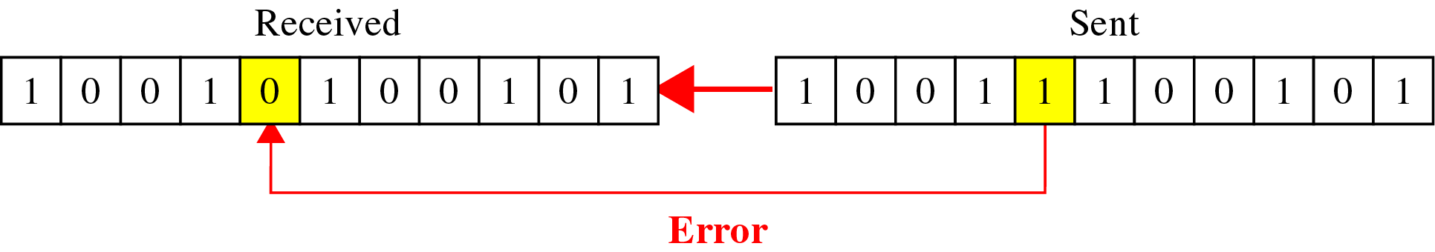
Error Correction(cont’d)
Error Detection and Correction

Slide 14
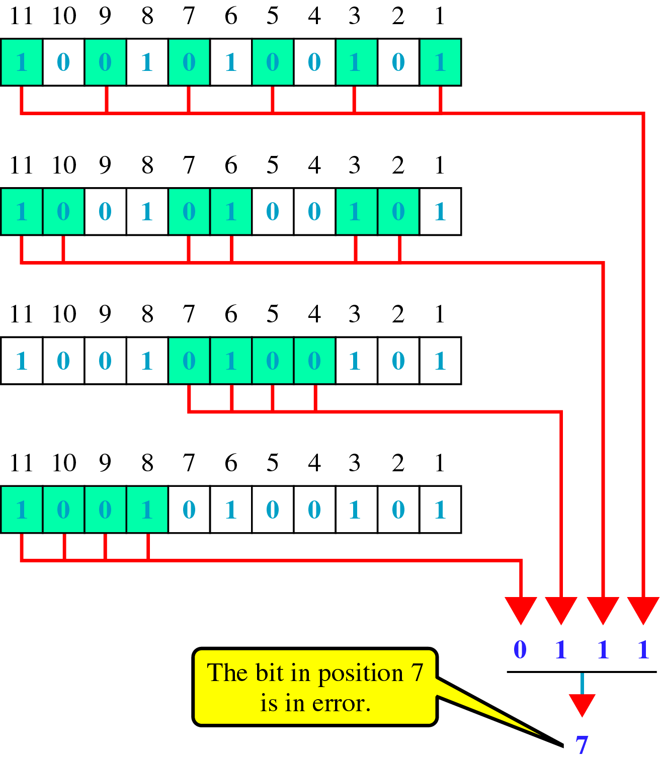
Error Correction(cont’d)
Error detection using Hamming Code

Slide 15
Check Your Understanding
Data : 10011010
Error in 2nd bit

Slide 16
Outcome
Student should be able to understand
Error correction code.

Slide 17
THANK YOU

